Slide 1

Get off your AMF and don’t REST on JSON
www.NTOBJECTives.com
www.manvswebapp.com

Slide 2

Today's Presenter
NT OBJECTives
  Member of NTO's founding team
  Leads security research team
  Leads vision and design of products
Blogger and Podcaster
  Man vs WebApp (formerly Mightyseek) - http://www.manvswebapp.com
  An Information Security Place Podcast - http://infosecplace.com
Open Source Developer
  Linux, Red Hat, Qmail Patches, phpGroupware, podPress, among others
Dan Kuykendall
Co-CEO & Chief Technology Officer
NT OBJECTives, Inc.
Twitter: @dan_kuykendall

Slide 3
Overview
Intro to Web Application security
Intro to SQL Injection
How Web Applications are changing
  Details about: AMF, REST, JSON
  Applying SQL Injection to these new formats
How this applies to Mobile Apps
Defenses
Conclusions

Slide 4
Overview
Intro to Web Application security
Intro to SQL Injection
How Web Applications are changing
  Details about: AMF, REST, JSON
  Applying SQL Injection to these new formats
How this applies to Mobile Apps
Defenses
Conclusions

Slide 5
Intro to Web Application Security
Understanding the landscape
www.NTOBJECTives.com

Slide 6
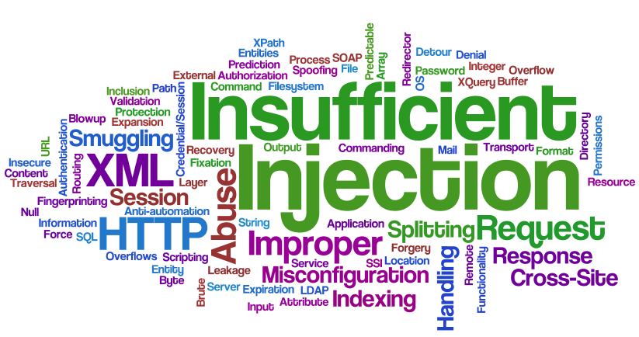
Web Application Security Defined
Testing of web application security controls
  Every input is an attack point
    Search field
    Profile
    Creditcard
Most common classes of attacks
  Against the application and database
    Steal confidential information (e.g. credit cards, social security numbers)
  Against the application users
    Use the application to attack client computers
    - Cross Site Scripting vulnerability

Slide 7
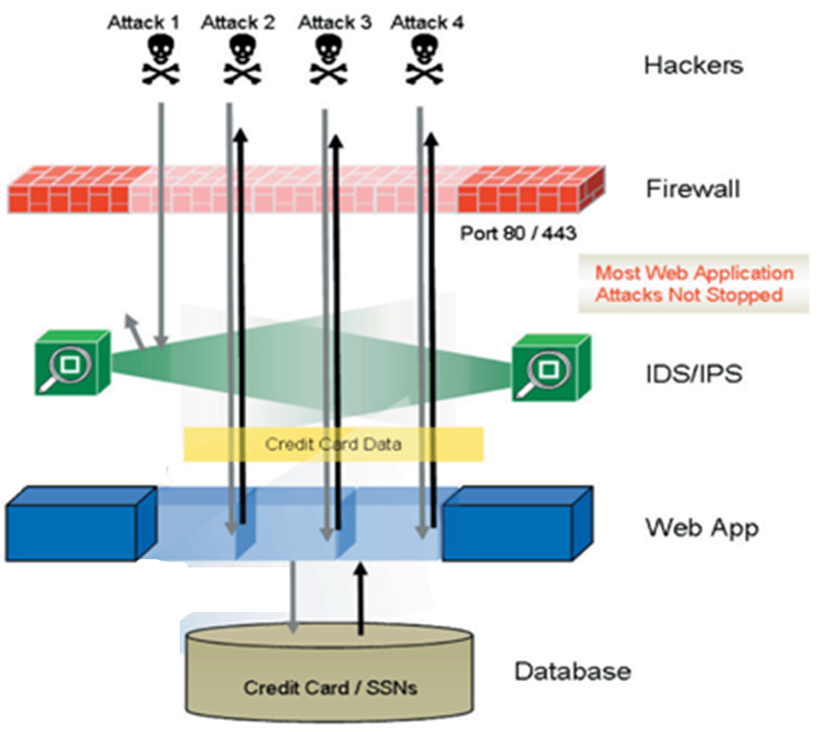
Web Application Security
Web applications often bypass normal security controls

Slide 8
Why Web Application Security Matters
Show me the $$$
Massive increase in E-Commerce and online record access
  FTC reports >10 million victims, over $5 billion in losses
Increasingly frequent attacks
Attacks are expensive and damaging to business
Legal & regulatory compliance pressures growing
Increased Legislation and Compliance requirements:
  PCI-DSS, HIPAA, Gramm-Leach-Bliley, Sarbanes-Oxley, state laws

Slide 9
Web Applications are changing
No longer just “HTML based” applications
Rich clients – AJAX/Flash/Flex/Silverlight
Mobile clients - Communicate over HTTP to backend services
More Protocols & Formats
  AMF, REST, JSON, SOAP, GWT-RPC, etc…

Slide 10
Changes create greater potential for danger
Internet
DMZ
Trusted
Web
Server
Server side
Processing
generates HTML
PHP, Ruby,
ASP.NET,
J2EE App Server,
etc.
C
O
R
E
R
E
S
O
U
R
C
E
s
Web
Client
DB
Rich
Client
Mobile, SOAP,
Flash, REST,
JSON, etc.
Web
Server
Passes request
To backend
Business
Logic
New
hole

Slide 11
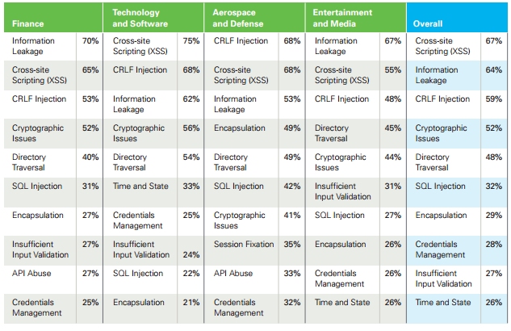
Hack Stats – Verizon / Veracode
Verizon report
  54% of attacks are against web applications
  92% of stolen records are from web application breaches
Vulnerability prevalence in Public Companies, by Industry
From:
Veracode’s
2012 Report

Slide 12
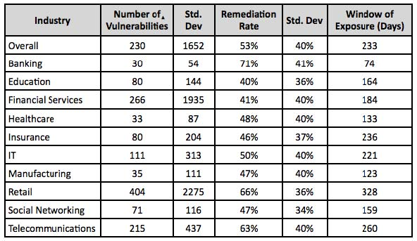
Security Statistics Report Winter 2011
How long does it take for website vulnerabilities to get fixed
(Window of Exposure).
From: Whitehat’s 2012 Report

Slide 13
Overview
Intro to Web Application security
Intro to SQL Injection
How Web Applications are changing
  Details about: AMF, REST, JSON
  Applying SQL Injection to these new formats
How this applies to Mobile Apps
Defenses
Conclusions

Slide 14
Intro to SQL Injection
Hacking the database
www.NTOBJECTives.com

Slide 15
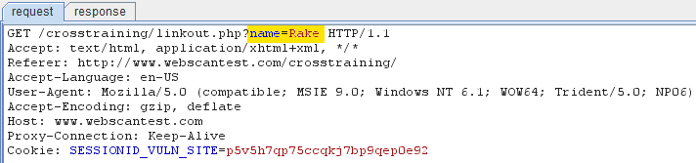
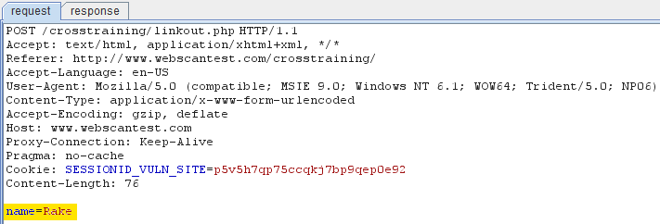
Hacking Traditional WebApps - Traffic
Inputs in simple ‘name=value’ pairs
Clicking on a link, the input is on the URL
Submitting a FORM, generates a POST requests

Slide 16
Web Apps using SQL
Common to take user input and generate a SQL Statement
Behind the scenes a SQL statement is waiting for user input
%name% will be replaced by the name value from the URL
SELECT * from tPeople WHERE lastname=‘%name%’

Slide 17
Web Apps using SQL
Common to take user input and generate a SQL Statement
Behind the scenes a SQL statement is waiting for user input
%name% will be replaced by the name value from the URL
All too often the input is dropped into the statement without escaping
invalid SQL statement
SELECT * from tPeople WHERE lastname=‘%name%’
SELECT * from tPeople WHERE lastname=‘O’Brian’

Slide 18
Web Apps using SQL
Common to take user input and generate a SQL Statement
Behind the scenes a SQL statement is waiting for user input
%name% will be replaced by the name value from the URL
All too often the input is dropped into the statement without escaping
invalid SQL statement
Developers should be escaping special characters (i.e. quote marks)
SELECT * from tPeople WHERE lastname=‘%name%’
SELECT * from tPeople WHERE lastname=‘O’Brian’
SELECT * from tPeople WHERE lastname=‘O\’Brian’

Slide 19
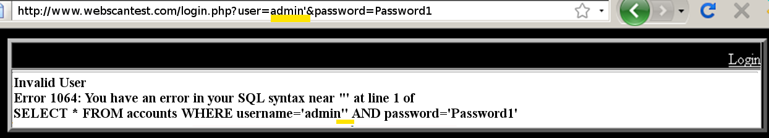
Standard SQL Injection Example
Often errors will be created and displayed
Attackers can use these errors as clues and then create an exploit
Example: admin’ or 1=‘1
If any account uses Password1 (most common password) then attacker is logged in.
SELECT * from tAccounts WHERE username=‘admin’’ AND password=‘Password1’
SELECT * from tAccounts WHERE username=‘admin’ or 1=‘1’ AND password=‘Password1’

Slide 20
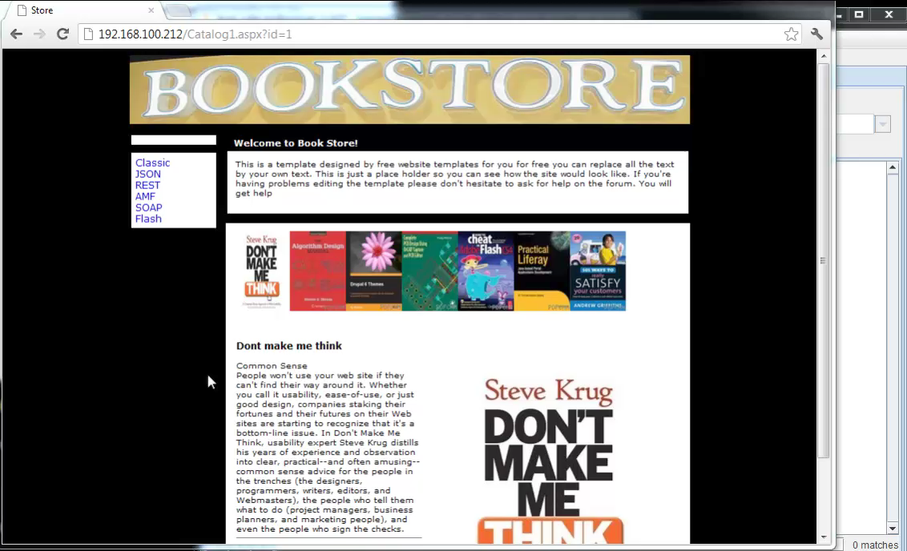
SQL Injection Demo: Classic web app

Slide 21
Overview
Intro to Web Application security
Intro to SQL Injection
How Web Applications are changing
  Details about: AMF, REST, JSON
  Applying SQL Injection to these new formats
How this applies to Mobile Apps
Defenses
Conclusions

Slide 22
Changing Landscape
The wild west is getting wilder
www.NTOBJECTives.com

Slide 23
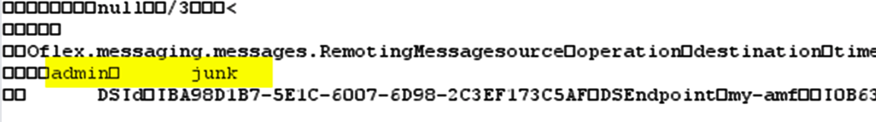
Popular new formats
Flash & Flex Applications
  AMF: Adobe/Actionscript Messaging Format
AJAX: Asynchronous JavaScript and XML
  REST: REpresentational State Transfer
  JSON: JavaScript Object Notation
There are several others that will not be covered today
http://example.com/catalog/item/17
{“catalog”: { “item”: 17 } }

Slide 24
AMF: Actionscript Messaging Format
Used by Flash & Flex applications
  Online games
  Marketing campaigns
Binary data object
Has 2 major versions (AMF0 and AMF3)
Decoders are available in many languages

Slide 25
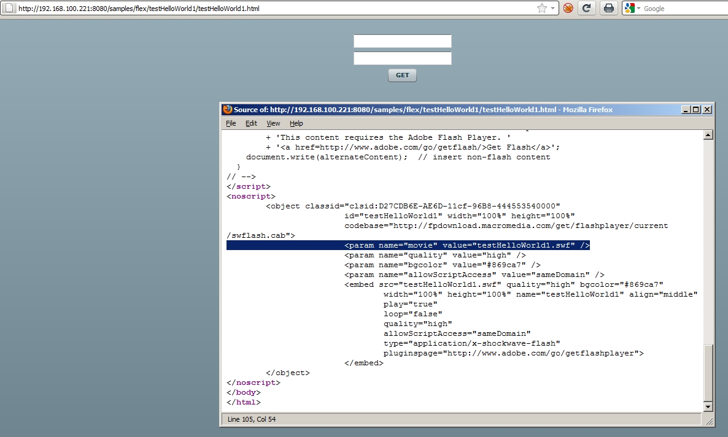
Hacking AMF – Loading applet

Slide 26
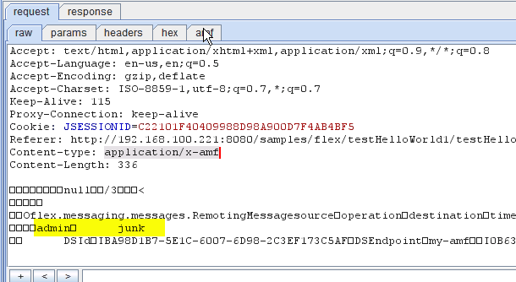
Hacking AMF – Raw traffic
Looks like binary garbage

Slide 27
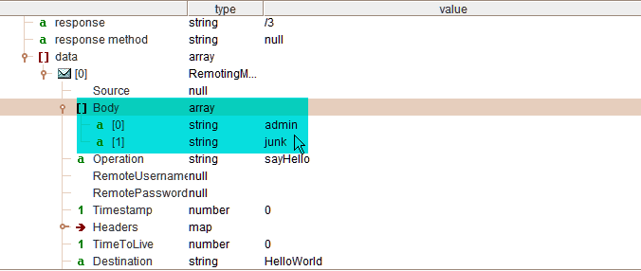
Hacking AMF – Decoded
AMF can be decoded and its easy to pinpoints the data elements

Slide 28
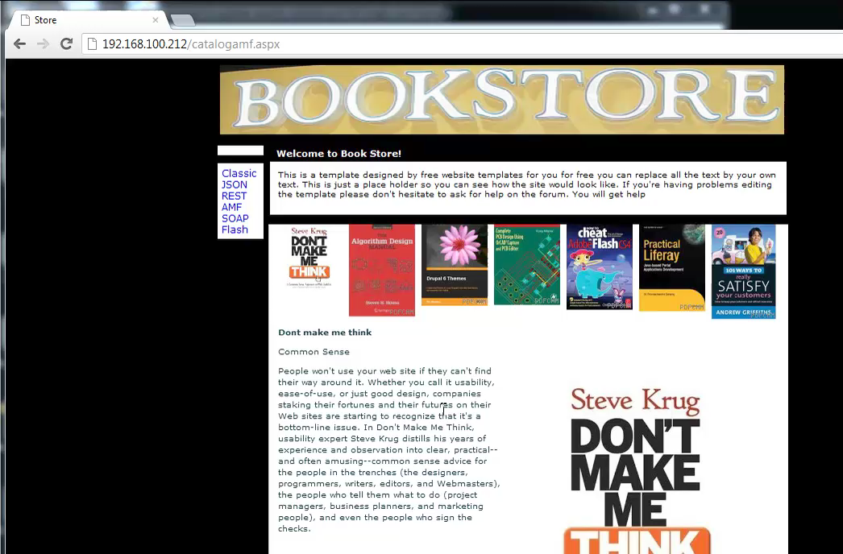
SQL Injection Demo: Using AMF

Slide 29
REST: REpresentational State Transfer
An Architectural Style, Not a Standard
RESTful applications provide often provide easily understood interfaces
The output could be in any chosen format
  Common RESTful file formats:
  RSS, ATOM, CSV, ICS, VCF
Mobile apps use RESTful services

Slide 30
RESTful Example - URI
Simple URI example
  Collection URI would provide list of record
  Element URI would provide record data
http://example.com/catalog/list/*
http://example.com/catalog/item/17

Slide 31
RESTful Example - XML
Simple XML example – XML sent in POST data
  Collection method would provide list of resources
  Element value would provide record data
POST /resources/
<Catalog><List>*</List></Catalog>
POST /resources/
<Catalog><id>17</id></Catalog>

Slide 32
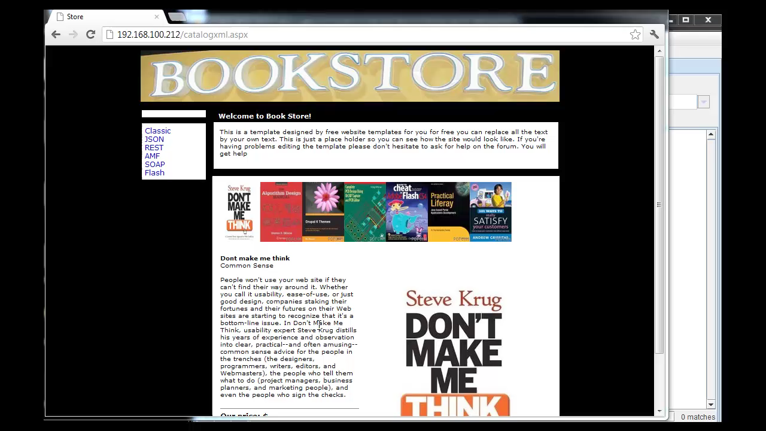
SQL Injection Demo: RESTful services

Slide 33
JSON: JavaScript Object Notation
Created specifically for JavaScript
Text based serialized arrays
Has become the most popular format in use because its easy to create & parse
Sent as GET parameter or POST data
AJAX: Asynchronous Javascript And XML
  JSON is native for AJAX frameworks, including jQuery
Mobile apps use JSON

Slide 34
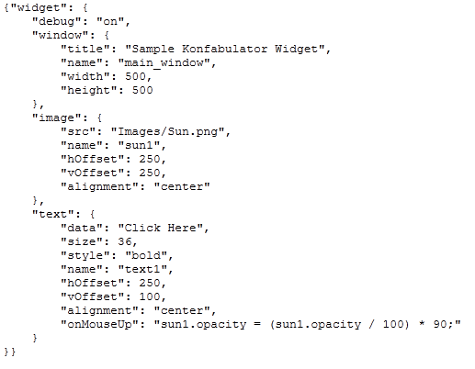
JSON: Example Traffic
Serialized array – Shown nicely formatted
Serialized array – As one line

Slide 35
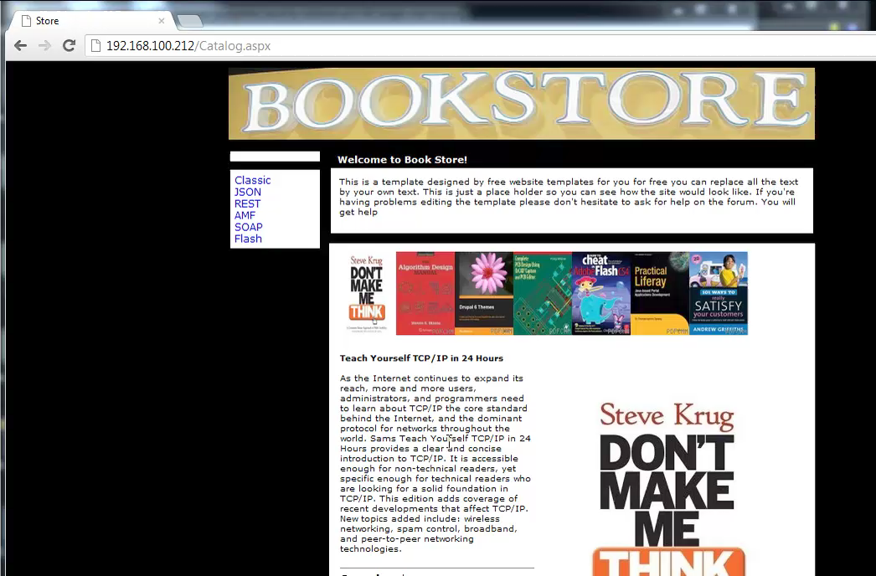
SQL Injection Demo: Using JSON

Slide 36
Overview
Intro to Web Application security
Intro to SQL Injection
How Web Applications are changing
  Details about: AMF, REST, JSON
  Applying SQL Injection to these new formats
How this applies to Mobile Apps
Conclusions

Slide 37
Mobile…
Who isn't talking about mobile these days
www.NTOBJECTives.com

Slide 38
Hacking Mobile Apps
Stop looking at the device in your hand…
  the real target is the on the backend
Get traffic data
  Run App in Emulator
  Proxy traffic from phone
    Transparent proxy on router
Mobile app formats
    JSON is native format used by many development toolkits
    REST is also used
    Some even use classic web app parameter format

Slide 39
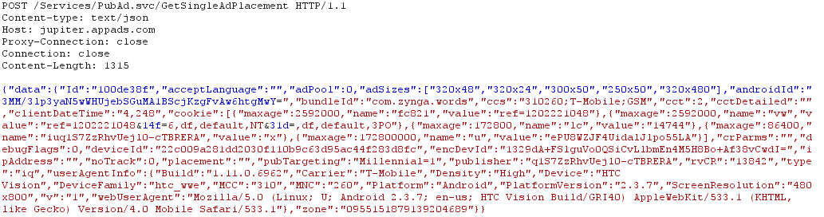
Hacking Mobile Apps – Words With Friends
Request to get advertising
Can you tell what format this is?

Slide 40
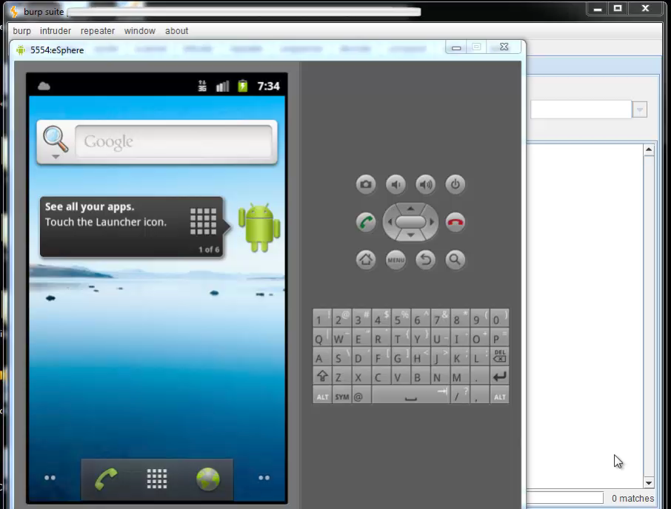
SQL Injection Demo: Mobile JSON

Slide 41
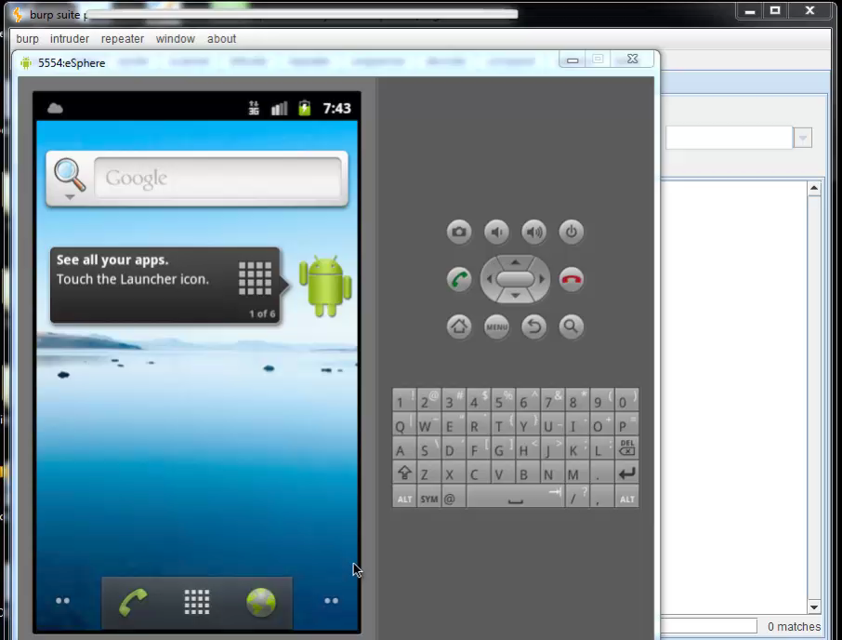
SQL Injection Demo: Mobile JSON Login

Slide 42
Overview
Intro to Web Application security
Intro to SQL Injection
How Web Applications are changing
  Details about: AMF, REST, JSON
  Applying SQL Injection to these new formats
How this applies to Mobile Apps
Conclusions

Slide 43
Conclusions
Knowing is half the battle
www.NTOBJECTives.com

Slide 44
Conclusions
Remember:
  Web applications are the primary target of malicious hackers
  Most web applications are vulnerable to attack
Attack payloads:
  We have understood SQL Injection for over 10 years yet on average 32% of applications are still vulnerable to SQL Injection
  And now, we are going beyond HTML to new formats and technologies, the vulnerabilities are growing faster than we can resolve them
  Learn about the different attack payloads (SQLi, XSS, LDAP injection, etc)

Slide 45
Conclusions
What you can do:
  Get to know these new technologies and formats, JSON, AMF, etc.
  Learn to watch traffic (Burp Suite)
  Practicing editing the traffic to force the application to throw error messages and enable you to discover vulnerabilities
Keep in mind:
  WAF’s do not understand these formats
  Web Application Scanners do not understand these formats
    Until NTOSpider 6.0

Slide 46
Comments & Questions
www.NTOBJECTives.com

